Slide 1

Let’s start with Allah Yaar
Bs in Computer Science

Slide 2
Private IP Addresses and Network Address Translation (NAT)
Private IP Addresses
Definition: Private IP addresses are IP addresses reserved for internal use within a private network. These addresses are not routable on the public internet, meaning they can only be used within a local area network (LAN). Devices using private IP addresses must rely on Network Address Translation (NAT) to communicate with external networks, such as the internet.

Slide 3
Private IP Addresses and Network Address Translation (NAT)
Private IP Ranges (as defined by IPv4 standards):
Class A: 10.0.0.0 to 10.255.255.255 (16,777,216 addresses)
Class B: 172.16.0.0 to 172.31.255.255 (1,048,576 addresses)
Class C: 192.168.0.0 to 192.168.255.255 (65,536 addresses)

Slide 4
Private IP Addresses and Network Address Translation (NAT)
Purpose: Private IP addresses conserve the limited IPv4 address space and ensure that local networks operate independently of public IP addresses. This setup is essential in homes, businesses, and organizations where multiple devices need unique IPs but don’t require public internet-facing addresses.

Slide 5
Private IP Addresses and Network Address Translation (NAT)
Network Address Translation (NAT)
Definition: Network Address Translation (NAT) is a process that maps private IP addresses within a local network to a public IP address used for external communication. NAT is typically implemented on a router or gateway that acts as the intermediary between the private network and the internet.

Slide 6
Private IP Addresses and Network Address Translation (NAT)
Types of NAT:
Static NAT: Maps one private IP address to one public IP address. Commonly used for servers or devices requiring constant public access.
Dynamic NAT: Assigns public IP addresses from a pool to private IP addresses dynamically. Suitable for larger networks with variable internet access requirements.

Slide 7
Private IP Addresses and Network Address Translation (NAT)
PAT (Port Address Translation) or NAT Overload: Maps multiple private IP addresses to a single public IP address using unique port numbers. This is the most common form of NAT.

Slide 8
Private IP Addresses and Network Address Translation (NAT)
How NAT Works:
A device with a private IP sends a data packet to an external server.
The router replaces the private IP with its public IP and sends the packet to the destination.
The external server responds to the public IP of the router.
The router uses its NAT table to route the response back to the originating private IP address.

Slide 9
Private IP Addresses and Network Address Translation (NAT)
Advantages of Private IP Addresses and NAT
Conservation of IPv4 Address Space:
Private IP addresses allow multiple devices to share a single public IP address, reducing the demand for public IPs.
Improved Security:
Devices with private IPs are not directly accessible from the internet, reducing vulnerability to attacks like unauthorized access or port scanning.

Slide 10
Private IP Addresses and Network Address Translation (NAT)
Ease of Network Design and Expansion:
Private IP ranges can be reused across different private networks without causing conflicts, making it easier to design and scale networks.
Cost Efficiency:
Organizations and users save on costs by not needing a unique public IP for every device.
Flexibility in Network Management:
NAT allows administrators to make internal changes to the network without affecting external communication.

Slide 11
Private IP Addresses and Network Address Translation (NAT)
Disadvantages of Private IP Addresses and NAT
Performance Overhead:
NAT introduces latency as the router processes each packet to modify headers and maintain the NAT table.
Limitations on Peer-to-Peer Communication:
Devices with private IPs cannot directly communicate with devices outside the private network unless port forwarding or a VPN is configured.

Slide 12
Private IP Addresses and Network Address Translation (NAT)
Complexity in Configuration:
NAT configurations, such as static NAT or port forwarding, require manual setup and troubleshooting expertise.
Compatibility Issues:
Some protocols, particularly those requiring end-to-end connectivity (e.g., certain VoIP or gaming applications), may face challenges working with NAT.
Lack of Transparency:
NAT hides internal IP addresses, making it difficult to trace the origin of network traffic for troubleshooting or auditing.

Slide 13
Private IP Addresses and Network Address Translation (NAT)
Conclusion
Private IP addresses and NAT have become essential for managing the scarcity of IPv4 addresses while ensuring secure, scalable, and efficient network designs. Despite certain limitations, they remain integral in modern networking, particularly in homes and enterprises. As IPv6 adoption increases, the dependency on NAT is expected to decrease, offering direct communication between devices without address translation.

Slide 14
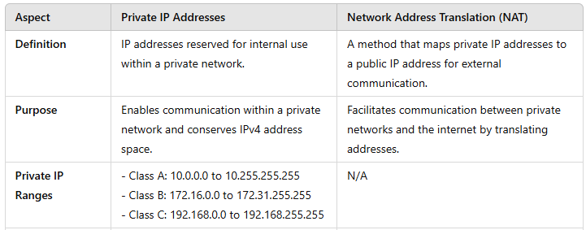
Summary Table

Slide 15
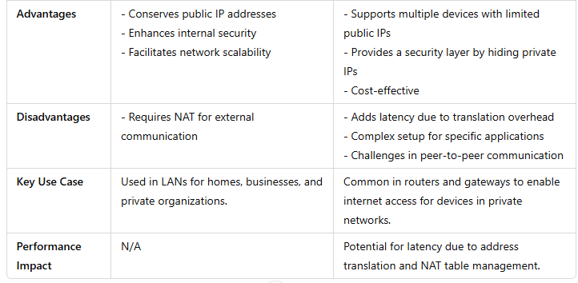
Summary Table

